Slide 1
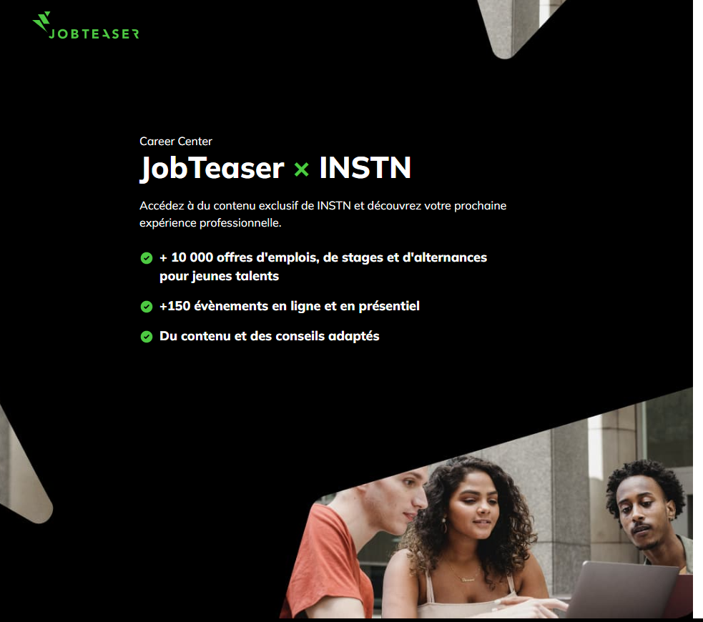
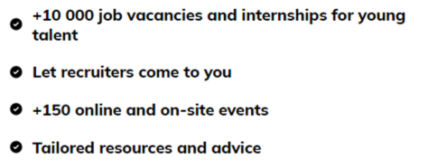
Purpose
The purpose of this presentation =>
COMMISSARIAT À L’ÉNERGIE ATOMIQUE ET AUX ÉNERGIES ALTERNATIVES

Slide 2
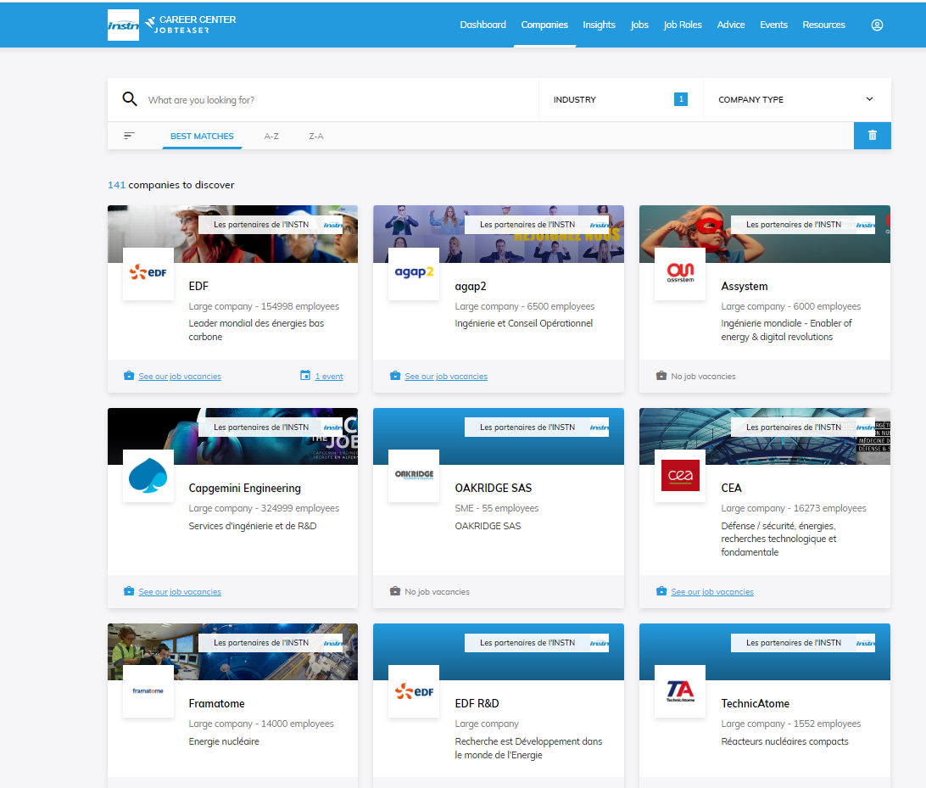
what's the BENEFIT for you with jobteaser
1. Unique professional network
COMMISSARIAT À L’ÉNERGIE ATOMIQUE ET AUX ÉNERGIES ALTERNATIVES

Slide 3
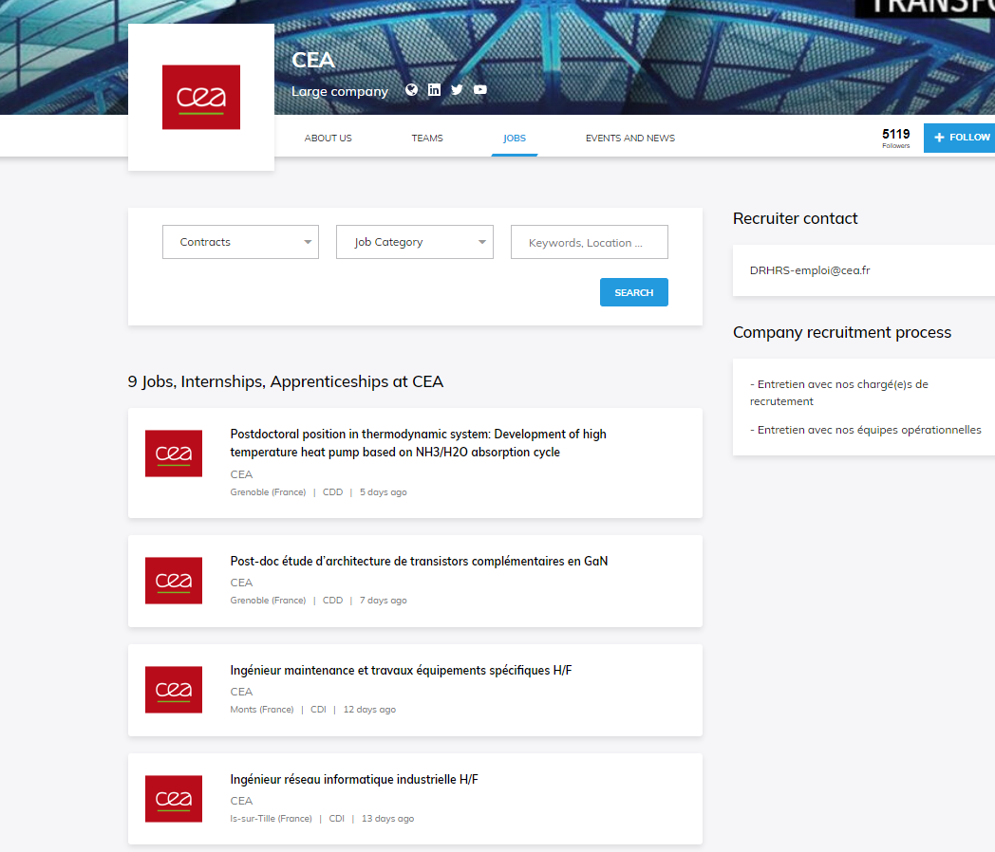
what's the BENEFIT for you with jobteaser
2. Jobs and Internship opportunities
COMMISSARIAT À L’ÉNERGIE ATOMIQUE ET AUX ÉNERGIES ALTERNATIVES

Slide 4
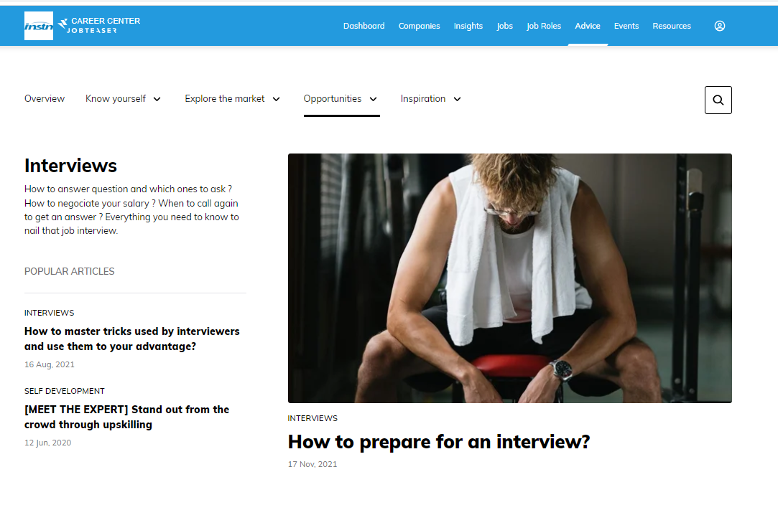
what's the BENEFIT for you with jobteaser
3. Tools & tips
COMMISSARIAT À L’ÉNERGIE ATOMIQUE ET AUX ÉNERGIES ALTERNATIVES

Slide 5
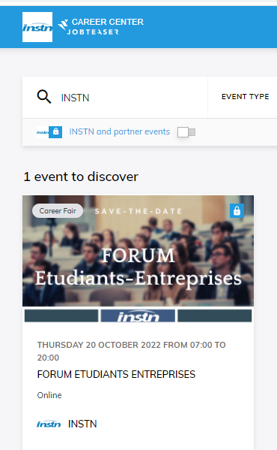
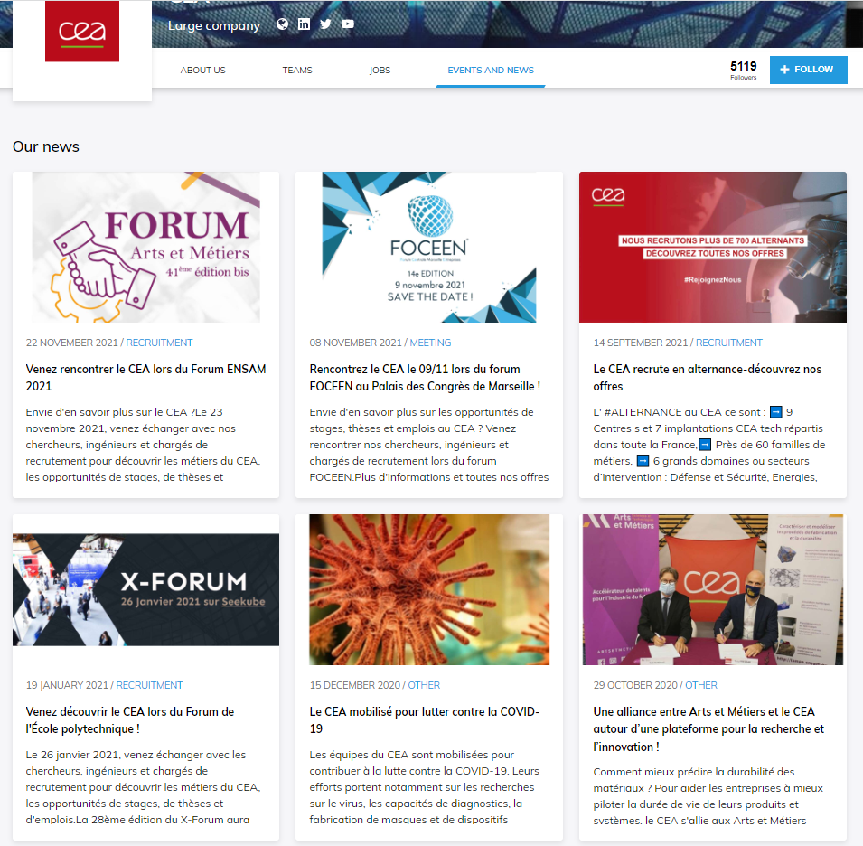
what's the BENEFIT for you with jobteaser
4. Events : INSTN events & external events
COMMISSARIAT À L’ÉNERGIE ATOMIQUE ET AUX ÉNERGIES ALTERNATIVES

Slide 6
INSTN FORUM
INSTN Forum : october 2023
Meet more the recruiters among leaders nuclear companies
Meet the alumni and their professionnel network
Learn from our human ressources workshops such as :
Stand out when applying for a job ;
Soft skills and soft competences, how and why to develop them animated by Naval Group;
Using your network to find a job;
Advice to women for a fulfilling career in the nuclear industry hosted by WIN.
COMMISSARIAT À L’ÉNERGIE ATOMIQUE ET AUX ÉNERGIES ALTERNATIVES

Slide 7
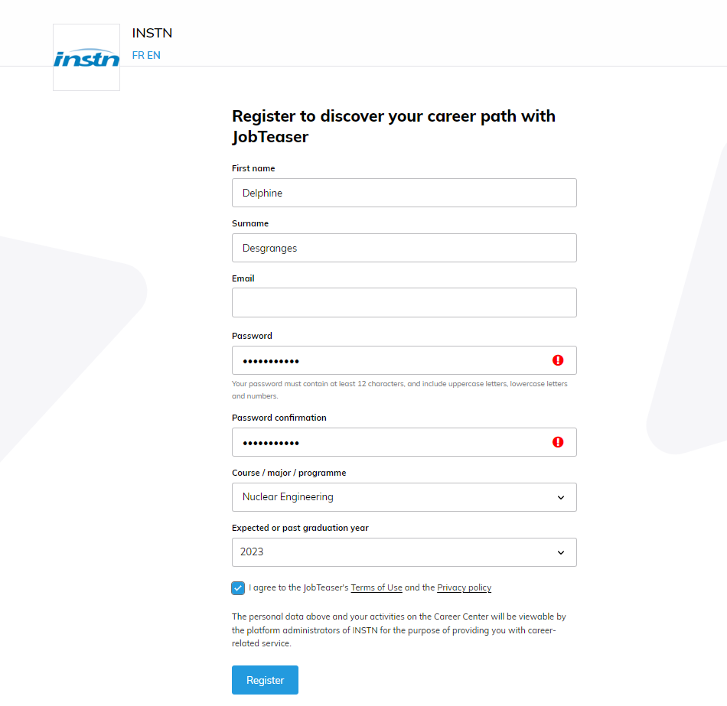
Register now
It easy => Go to
http://instn.jobteaser.com/
It’s quick =>
less than 30 secondes to create you simple profil
COMMISSARIAT À L’ÉNERGIE ATOMIQUE ET AUX ÉNERGIES ALTERNATIVES

